Slide 1

Mood Tracker
A simple Python project for tracking daily moods
By Anjali Solanki

Slide 2
Project Overview
What is Mood Tracker?
A simple Python project to log daily moods and short notes.
Saves all mood entries in a lightweight JSON file for easy storage.
Lets me search and view moods by date or by mood type.
Helps track emotional trends over time in a user-friendly way.
Designed to be modular, clear, and easy to maintain.

Slide 3
Approach & Design
Designed a simple command-line application for easy user interaction.
Structured the code using modular functions and reusable helpers.
Applied input validation for correct date format and mood consistency.
Used a JSON file for persistent data storage — easy to read and test.
Followed the DRY principle (Don’t Repeat Yourself) to avoid code duplication.

Slide 4
Key Files & Folders
Mood_Tracker.ipynb
→ Contains all Python code, organized into clear Colab cells: setup, helpers, logging, viewing, main menu.
mood_data.json
→ Stores all logged moods and notes in a simple JSON format — easy to view, edit, and verify.
Structure:
→ No extra folders needed , lightweight, single-file storage keeps the project simple and portable.

Slide 5
Process to Run & Test
Open the Colab notebook and run each cell in order to load all code blocks.
Use the interactive menu: → 1: Log a new mood → 2: View moods by date or mood type → 3: Exit the tracker
Check mood_data.json: → Confirms that moods are stored and updated correctly.
Add test entries: → Log a few moods in advance to demonstrate viewing and filtering.
Verify output: → Filter results by date or mood to check correctness.

Slide 6
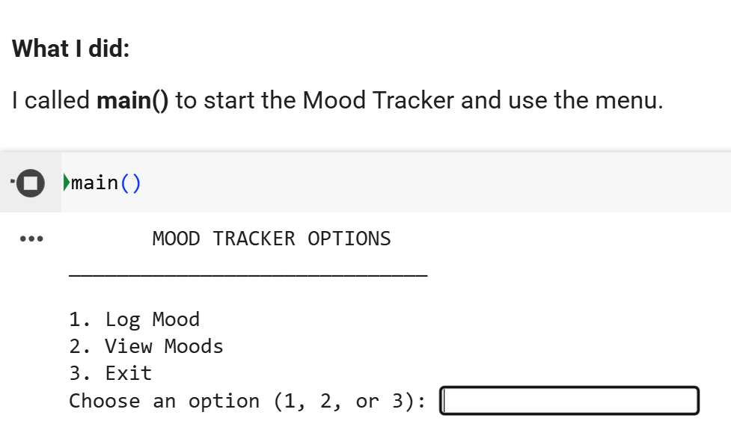
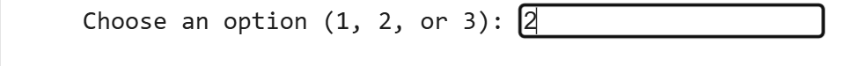
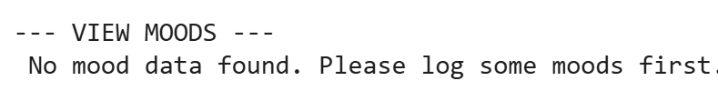
Let’s Check

Slide 7
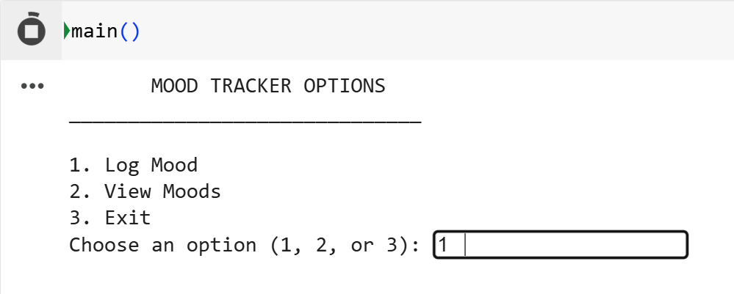
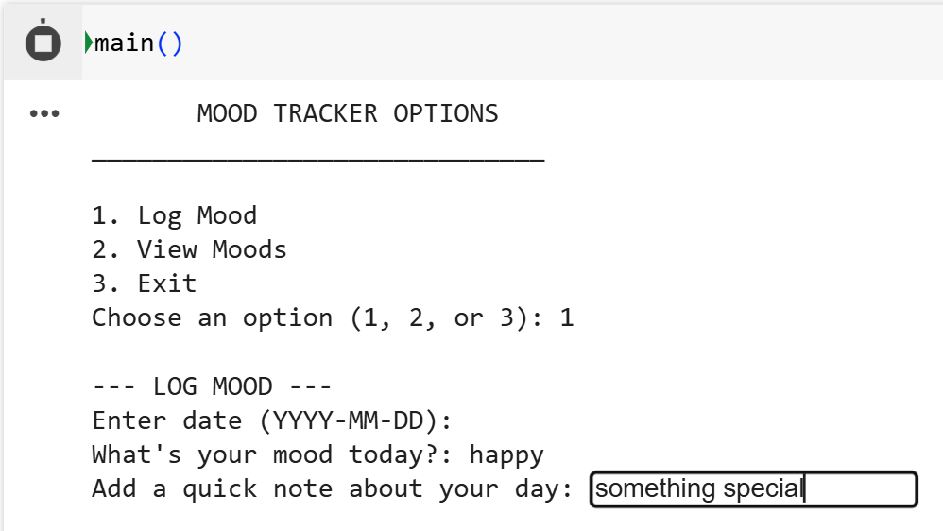
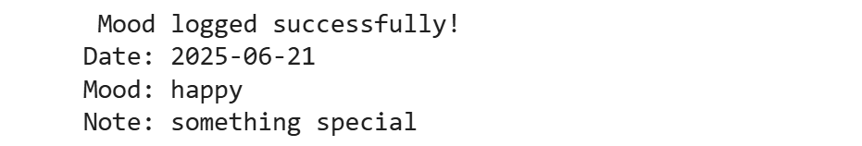

Slide 8
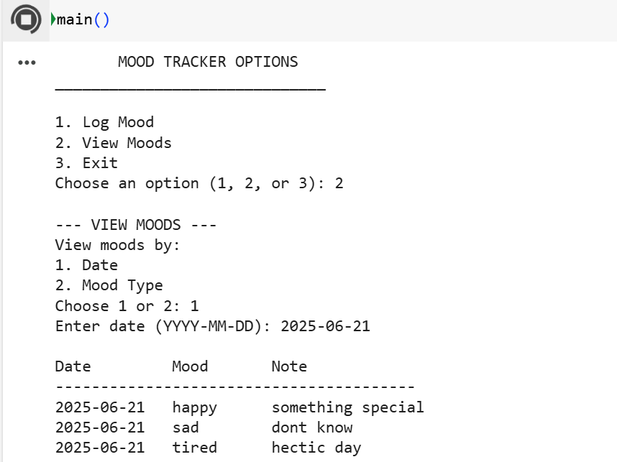

Slide 9
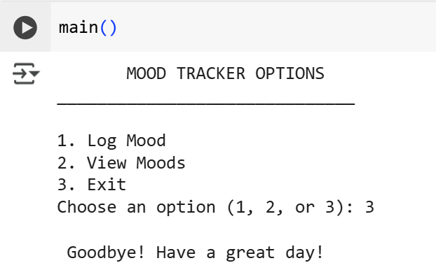

Slide 10
Thank you

